Slide 1


Slide 2


Logistics
Check your email for testing room location. Know where you’re going! Being prepared reduces anxiety.
Set a reminder to fully charge your laptop Tuesday night.
Don’t worry…Today is NOT a study lesson!

Slide 3
Do Your Best!
Exposure matters. Even though you may not hit it now, you can register to take the test as many times as you want to hit your benchmark.
Don’t worry about your PSAT score. You’ve had more MATH since then!
We automatically receive your test scores, and you will get your point asap!

Slide 4

Rights-only scoring
ABOUT THE SAT®
Reading & Writing
Total time: 64 minutes
Sections (modules): 2
  Module 1: 32 minutes
  Module 2: 32 minutes
Number of questions: 54 total, 27 questions per module
Math
Total time: 70 minutes
Sections (modules): 2
  Module 1: 35 minutes
  Module 2: 35 minutes
Number of questions: 44 total, 22 questions per module
⏱️ Break
There is one 10-minute break
  It comes between Reading & Writing and Math
No break between modules within a section.
🕒 Total Testing Time
2 hours 14 minutes of testing

Slide 5
Rights-only scoring
ABOUT THE SAT®
1. Rights-only scoring.
Students earn points
for each correct answer.
There’s no penalty
for guessing.

Slide 6
No obscure vocabulary
ABOUT THE SAT®
2. No obscure vocabulary.
The SAT focuses on words students are most likely to use
again throughout college and career.
Students won’t see words like “prevaricate” or “sagacious.”

Slide 7
More focused math
ABOUT THE SAT®
3. More focused math.
Focuses on the math skills most widely used in college and career.
Most questions are multiple choice.
Calculators are allowed on only one section. Some questions are easier to solve without a calculator. YOU ARE PROVIDED A CALCULATOR.

Slide 8
Analysis, not opinion
ABOUT THE SAT®
4. Analysis, not opinion.
Use evidence from the text to
support their analysis.

Slide 9
Analysis, not opinion
ABOUT THE SAT®
Tip 5: Pay Attention to Connotation
This tip is critical for answering tough questions in the SAT Reading and Writing section.
Look for words that indicate positive or negative connotation in the part of the passage that the question references.
This can help you to eliminate at least a couple of choices even if you have no idea which of the remaining choices is correct.

Slide 10
Analysis, not opinion
ABOUT THE SAT®
Tip 6: Be Careful with “NO CHANGE” Answers
If you notice that you’re answering NO CHANGE or NONE OF THE ABOVE for lots questions, you should go back and double-check your answers.
“NO CHANGE” will only be the answer for 25 percent or less of the questions where it's an option.

Slide 11
Analysis, not opinion
ABOUT THE SAT®
Tip 7: Skip Difficult Questions
If you're having trouble with a question, skip it and move on before you waste too much time. Lingering on hard questions could cost you easy points if it means you’re not getting to questions later in the section.
For the Math section, don’t spend more than 70 seconds trying to figure out each question.
For the Reading and Writing section, don’t spend more than 90 seconds.
Mark any questions that you skip so that they’re easier for you to pick out when you go back through the section.
If you still can't figure out the answer, take a guess! The digital SAT has no guessing penalty.

Slide 12
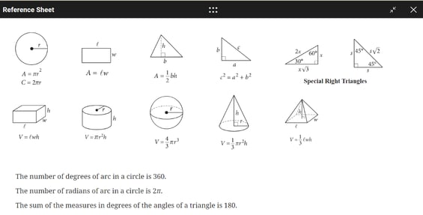
Tip 8: Don't Worry About Memorizing a Lot of Formulas
Some good news: you don't need to memorize a ton of formulas for SAT Math! For the entire Math section, you’ll be able to access a reference popout that includes formulas
Here’s an example of what the popout will look like:

Slide 13
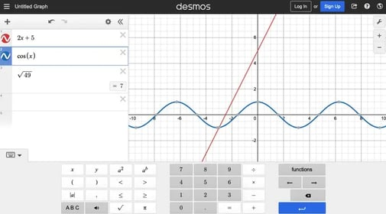
Why take it
DESMOS
CALCULATOR
Tip 9: Know How to Use the Desmos Onscreen Calculator
Built into the Bluebook testing application is a Desmos graphing calculator that you can use on the entire Math section.
It allows you to graph lines and curves, plot points, locate x- and y-intercepts, and complete various other calculations.
If you’re planning to use the Desmos calculator, experiment with the device online

Slide 14
Let’s check email & update Bluebook!

